Slide 1

HCI - Assignment n.2
Design and prototyping of an application using a human-centered approach
Deliverable n. 1: Requirement Analysis
Project Title: Plataforma de preparação para PNA
Group: Bruno Acioli, Marco Magalhães & Patrícia Cardoso
Lab Class: P3
HCI 2020-2021

Slide 2
Introduction
Plataforma de preparação para PNA
Marco’s sister is preparing for the PNA (National Access Exam) so we decided to build this platform to help her and every medical student that needs to prepare for the exam.
Every medical student has to do this exam at the end of their course to choose the speciality of their clinical clerkship and the hospital place.
This project is only for this discipline.
HCI 2020-2021
2

Slide 3
Project Objectives
Plataforma de preparação para PNA
Prepare the biggest amount of medical students and provide them with the best resources to do the clinical clerkship of their dreams.
Filter all the topics needed for the exam
Advice the students with the best bibliography
Increase the reputation of the institution that uses the platform
HCI 2020-2021
3

Slide 4

Personas
Plataforma de preparação para PNA
Name: Maria Beatriz
Age: 23 years old
Occupation: Medical student
Family status: Single, no children
Residence: Braga, Portugal
Education: Medical student in University of Minho
Goals: To adequately prepare for the PNA, achieve a good score on the exam, and be accepted into the program that she wants.
Challenges: Maria Beatriz has difficulty choosing the correct study material for the exam, as there is a lot of information available online and she has limited time to study. She is also concerned about her preparation, so she is looking for a platform that can provide her with the best resources
HCI 2020-2021
4

Slide 5
Scenarios
Plataforma de preparação para PNA
Scenario 1: Answer a prepared exam with filtered questions from previous exams
User: Maria Beatriz
Motivation: Having a better preparation for the PNA
Goal: Provide material for a better preparation
Maria Beatriz can resolve the tests that were already prepared by professors to study for her exam
Scenario 2: Student wants to schedule an appointment with a professor
User: Maria Beatriz
Motivation: She has doubts about some topics
Goal: Solve her doubts
Maria Beatriz picks a professor and schedule an appointment with him/her to have a better understanding of the subjects she has doubts.
HCI 2020-2021
5

Slide 6
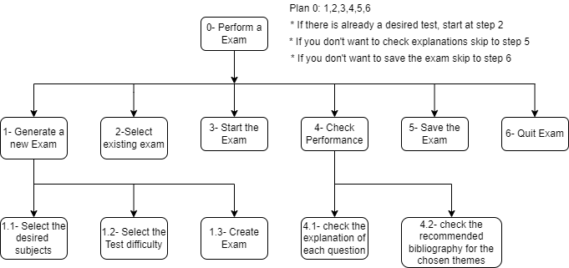
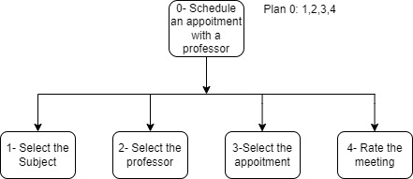
Tasks
Plataforma de preparação para PNA
HCI 2020-2021
6

Slide 7
Requirements
Plataforma de preparação para PNA
Define a set of requirements (non-functional, functional, …) based on the objectives and personas:
Non-functional requirements – Easy to use, performance, scalability and compliance
Functional Requirements - User authentication, exam resolution, check books to buy and schedule appointment with a professor and suggest questions to the test
HCI 2020-2021
7

Slide 8
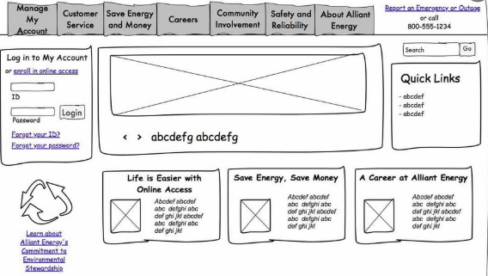
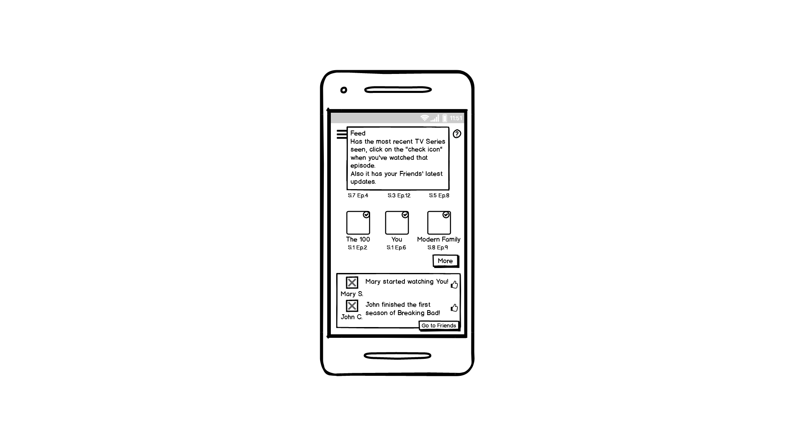
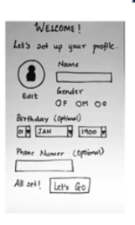
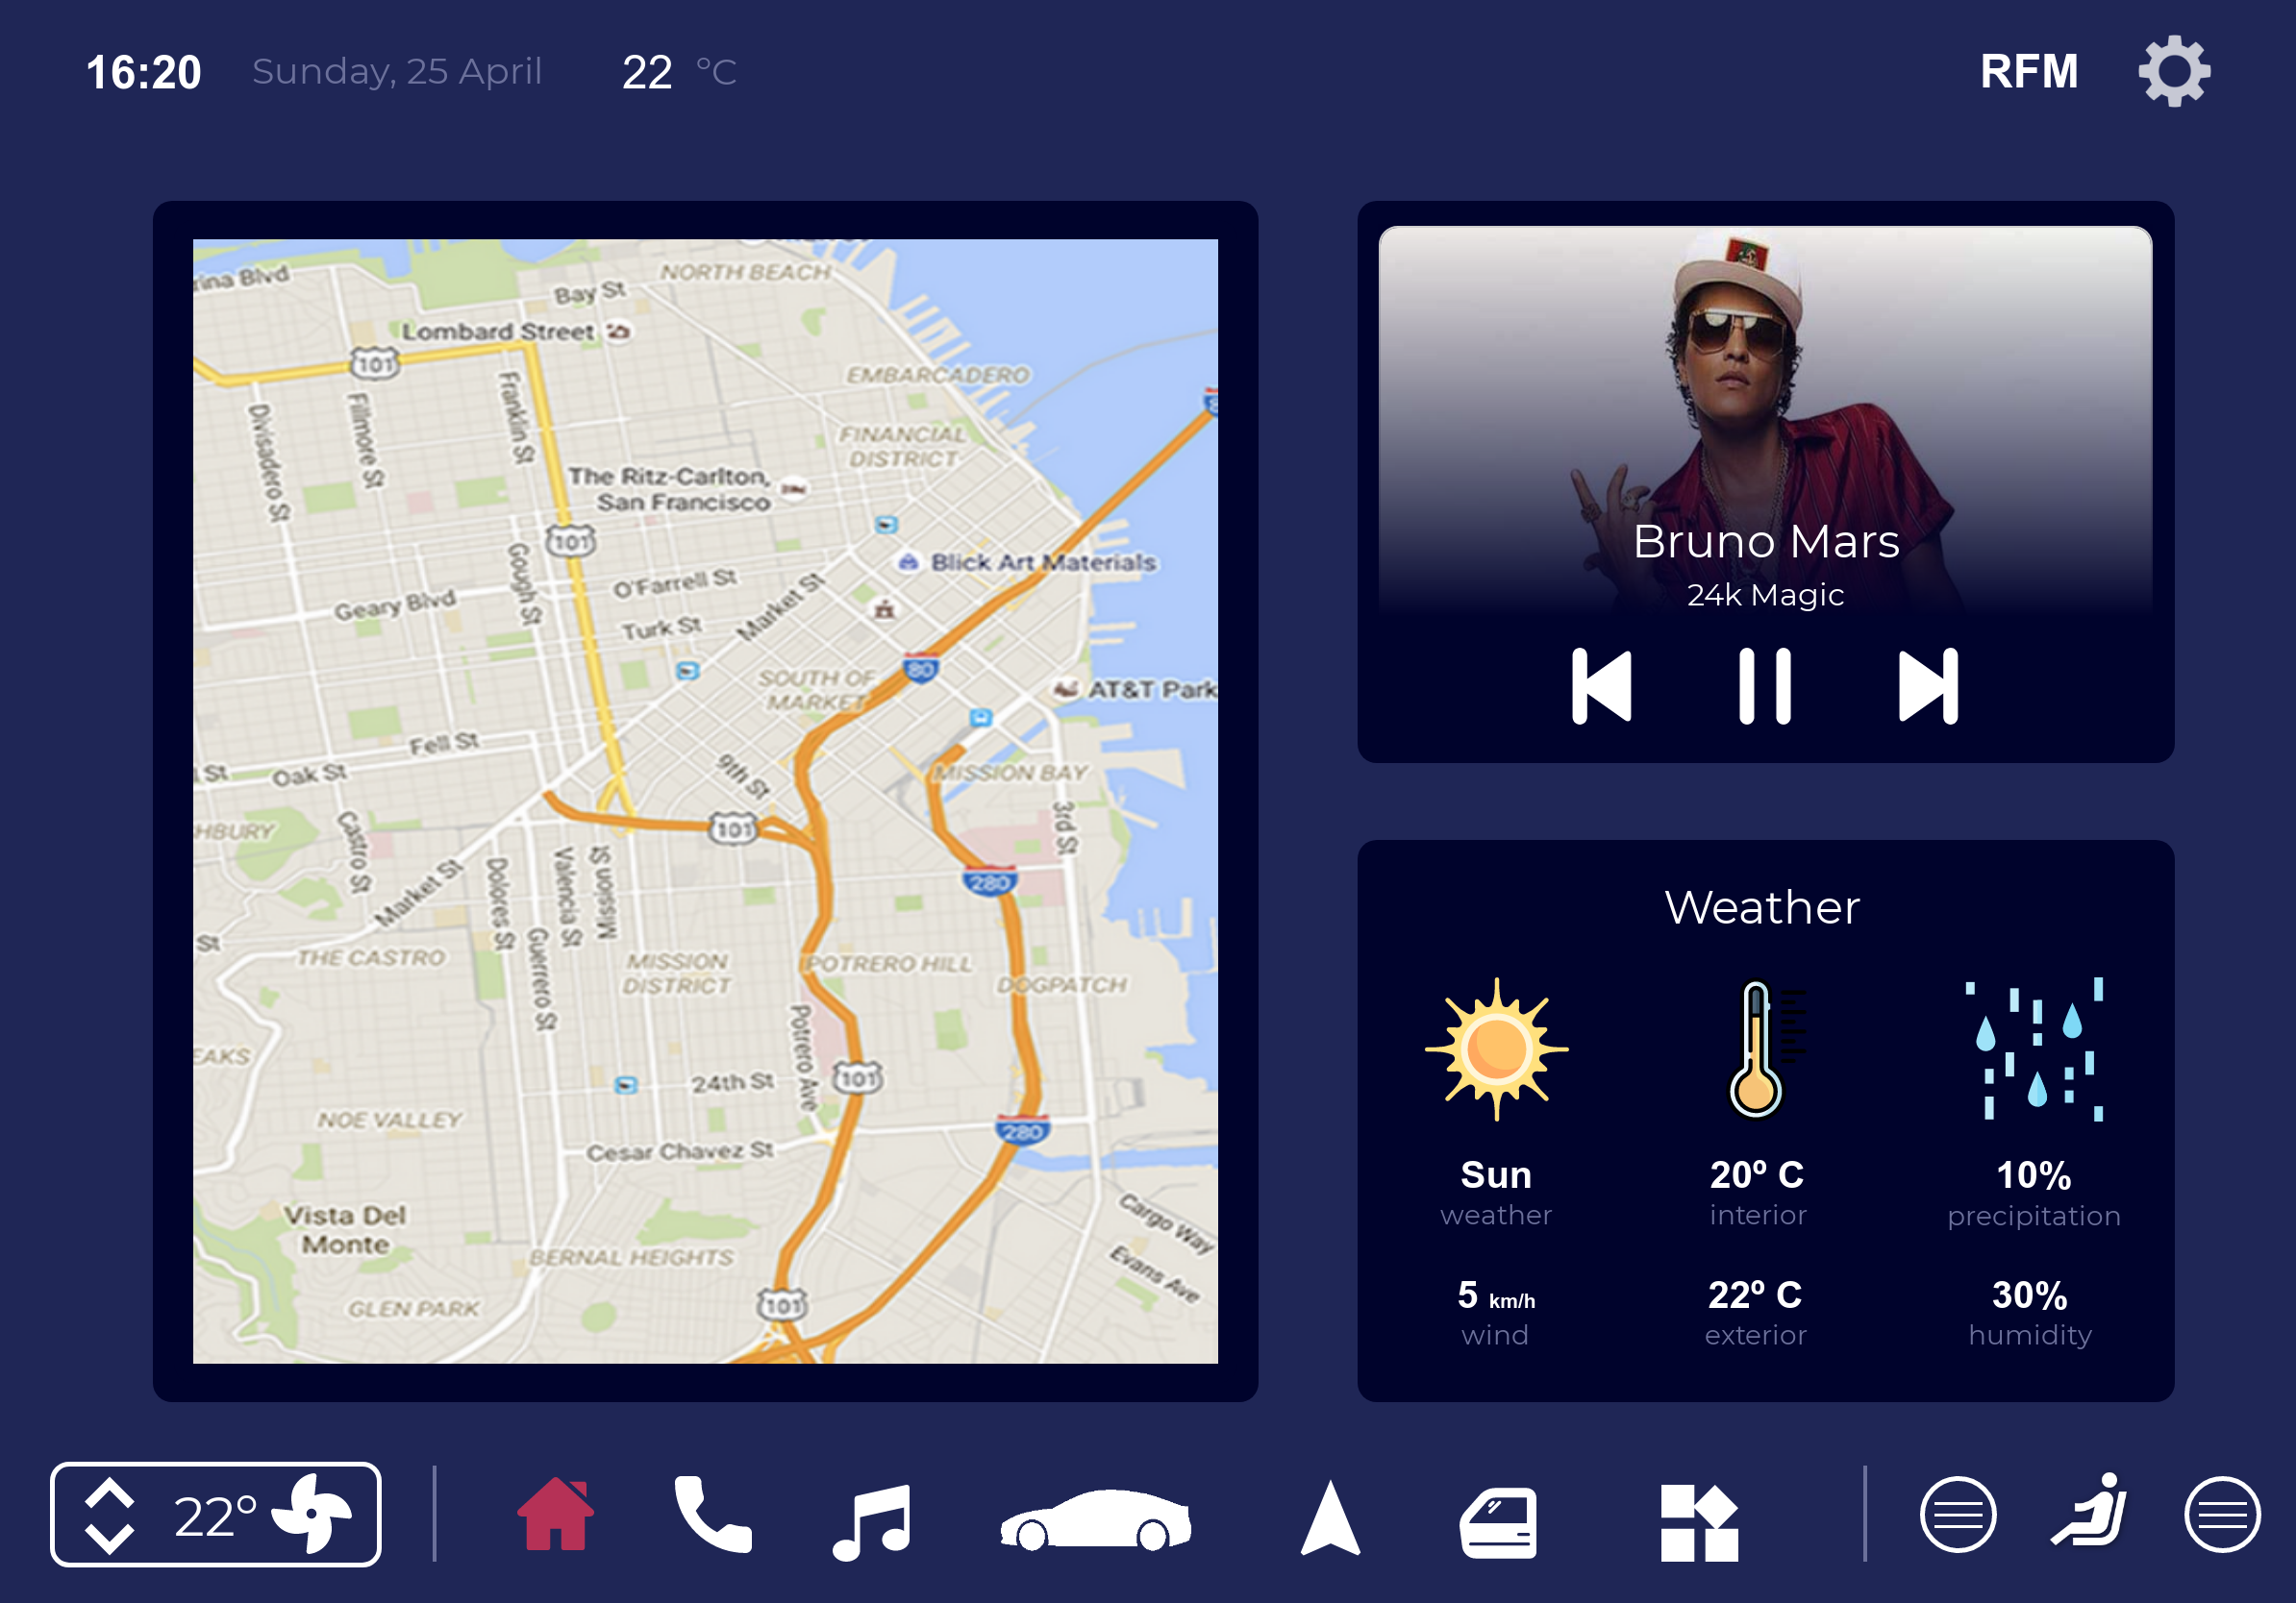
Next steps
Plataforma de preparação para PNA
What type of prototype are you considering?
Answer: Paper
How will you test it?
Answer: Give it to Marco’s sister and her friends
HCI 2020 - 2021
8

